Slide 1
Rule Generation
Given a frequent itemset L, find all non-empty subsets f ⊂ L such that f → L – f satisfies the minimum confidence requirement
  If {A,B,C,D} is a frequent itemset, candidate rules:
    ABC →D, ABD →C, ACD →B, BCD →A,
    A →BCD, B →ACD, C →ABD, D →ABC
    AB →CD, AC → BD, AD → BC, BC →AD,
    BD →AC, CD →AB,
If |L| = k, then there are 2^{k} – 2 candidate association rules (ignoring L → ∅ and ∅ → L)

Slide 2
Rule Generation
How to efficiently generate rules from frequent itemsets?
  In general, confidence does not have an anti-monotone property
    c(ABC →D) can be larger or smaller than c(AB →D)
  But confidence of rules generated from the same itemset has an anti-monotone property
  e.g., L = {A,B,C,D}:
  c(ABC → D) ≥ c(AB → CD) ≥ c(A → BCD)
    Confidence is anti-monotone w.r.t. number of items on the RHS of the rule

Slide 3
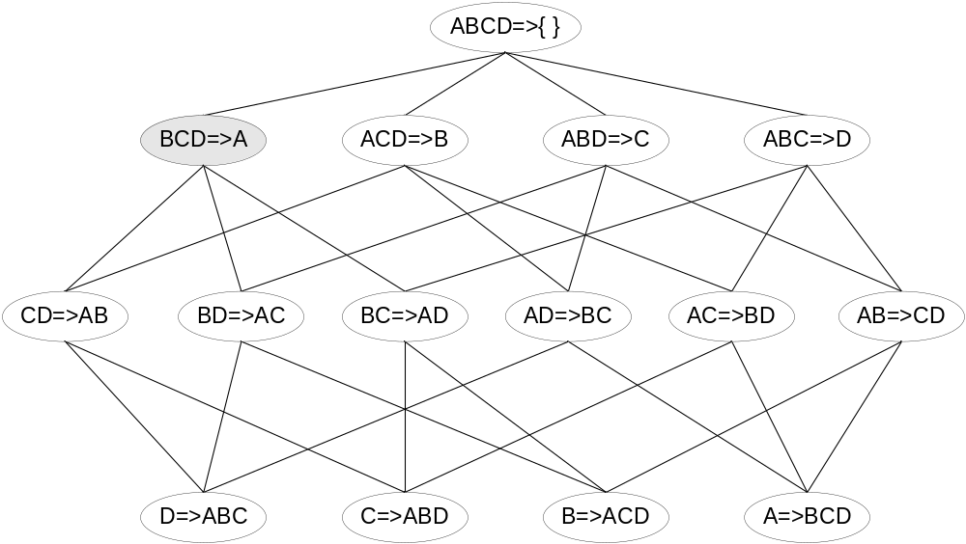

Rule Generation for Apriori Algorithm
Lattice of rules
Low Confidence Rule
Pruned Rules

Slide 4
Compact Representation of Frequent Itemsets
In practice, the number of frequent itemsets produced from a transaction data set can be very large
It is useful to identify a small representative set of itemsets from which all other frequent itemsets can be derived
Two such representations are the maximal and closed frequent itemsets

Slide 5
Maximal Frequent Itemsets
A maximal frequent itemset is defined as a frequent itemset for which none of its immediate supersets are frequent
To illustrate this concept, consider the itemset lattice shown in the next slide
The itemsets in the lattice are divided into two groups – those that are frequent and those that are infrequent
A frequent itemset border, represented by a dashed line, is also shown in the diagram. Every itemset located above the border is frequent, while those located below the border (shaded nodes) are infrequent
Among the itemsets residing near the border, {a, d}, {a, c, e} and {b, c, d, e} are considered to be maximal frequent itemsets because their immediate supersets are infrequent. An itemset such as {a, d} is maximal frequent because all of its immediate supersets {a, b, d}, {a, c, d} and {a, d ,e} are infrequent. In contrast, {a, c} is non-maximal because one of its immediate supersets {a, c, e} is frequent

Slide 6
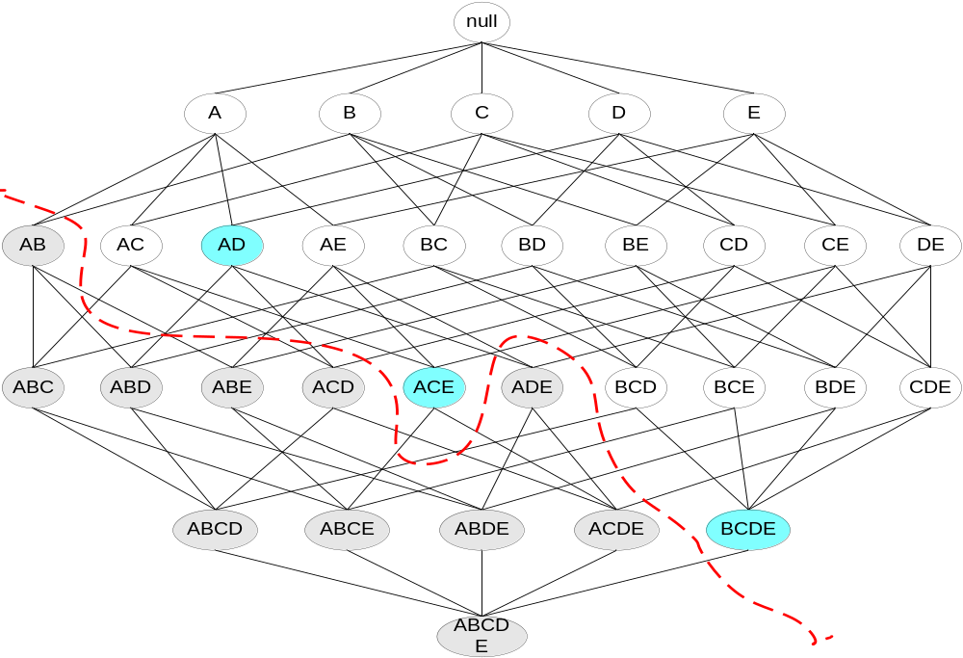
Maximal Frequent Itemset
An itemset is maximal frequent if none of its immediate supersets is frequent
Maximal Itemsets
Infrequent Itemsets
Border

Slide 7
Maximal Frequent Itemsets
Maximal frequent itemsets effectively provide a compact representation of frequent itemsets. In other words, they form the smallest set of itemsets from which all frequent itemsets can be derived
For example, the frequent itemsets in the previous slide can be divided into two groups:
Frequent itemsets that begin with item a and that may contain items c, d or e. This group includes itemsets such as {a}, {a, c}, {a, d}, {a, e} and {a, c, e}.
Frequent itemsets that begin with items b, c, d or e. This group includes itemsets such as {b}, {b, c}, {c, d}, {b, c, d, e} etc.
Frequent itemsets that belong to the first group are subsets of either {a, c, e} or {a, d}, while those that belong to the second group are subsets of {b, c, d, e}. Hence, the maximal frequent itemsets {a, c, e}, {a, d} and {b, c, d, e} provide a compact representation of the frequent itemsets
Maximal frequent itemsets provide a valuable representation for data sets that can produce very long, frequent itemsets, as there are exponentially many frequent itemsets in such data
Nevertheless, this approach is practical only if an efficient algorithm exists to explicitly find the maximal frequent itemsets without having to enumerate all their subsets
Despite providing a compact representation, maximal frequent itemsets do not contain the support information of their subsets. For example, the support of the maximal frequent itemsets {a, c, e}, {a, d} and {b, c, d, e} do not provide any hint about the support of their subsets. An additional pass over the dataset is therefore needed to determine the support counts of the non-maximal frequent itemsets

Slide 8
Closed Frequent Itemsets
An itemset X is closed if none of its immediate supersets has exactly the same support count as X
Closed itemsets provide a minimal representation of itemsets without losing their support information.
Put another way, X is not closed if at least one of its immediate supersets has the same support count as X
An itemset is a closed frequent itemset if it is closed and its support is greater than or equal to minsup
Consider the diagram in the next slide, where each node is annotated with a list of its corresponding transactions IDs
For example, the node {b, c} is associated with transaction IDs 1, 2 and 3 and its support count is 3.
From the transactions, note that every transaction that contains b also contains c. Thus, the support of {b} is identical to the support of {b, c} and {b} should not be considered a closed itemset.
Similarly, since c occurs in every transaction that contains both a and d, the itemset {a, d} is not closed.
On the other hand, {b, c} is a closed itemset as it does not have the same support count as any of its supersets.

Slide 9
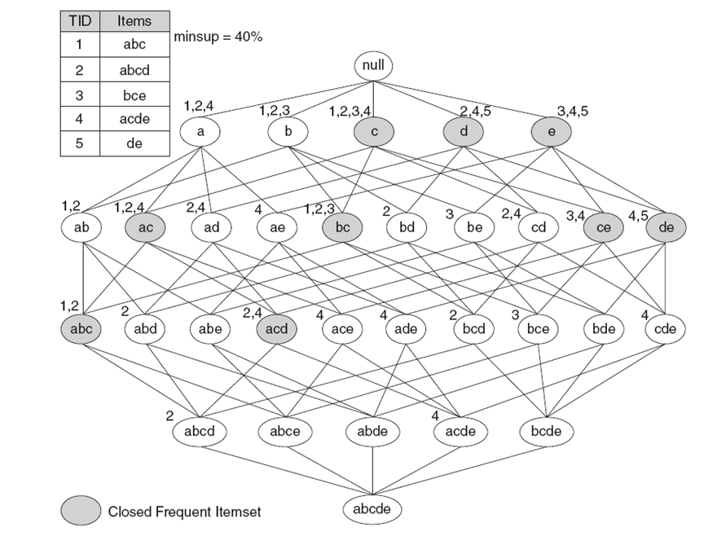
Closed Frequent Itemsets

Slide 10
Closed Frequent Itemsets
In the previous slide, assuming the support threshold is 40%, {b, c} is a closed frequent itemset because its support is 60%.
The rest of the closed frequent itemsets are indicated by the shaded nodes
Algorithms are available to explicitly extract the closed frequent itemsets from a given dataset
We can use the closed frequent itemsets to determine the support counts of the non-closed frequent itemsets.
For example, consider the frequent itemset {a, d} shown in the figure. Because the itemset is not closed, its support count must be identical to one of its immediate supersets.
The key is to determine which superset among {a, b, d}, {a, c, d} or {a, d, e} has exactly the same support count as {a, d}.
The Apriori principle states that any transaction that contains the superset of {a, d} must also contain {a, d}. However, any transaction that contains {a, d} does not have to contain the supersets of {a, d}.
For this reason, the support of {a, d} must be equal to the largest support among its supersets.
Since {a, c, d} has a larger support than both {a, b, d} and {a, d, e}, the support of {a, d} must be identical to the support of {a, c, d}.
Using this method, an algorithm can be constructed to compute the support for the non-closed frequent itemsets

Slide 11
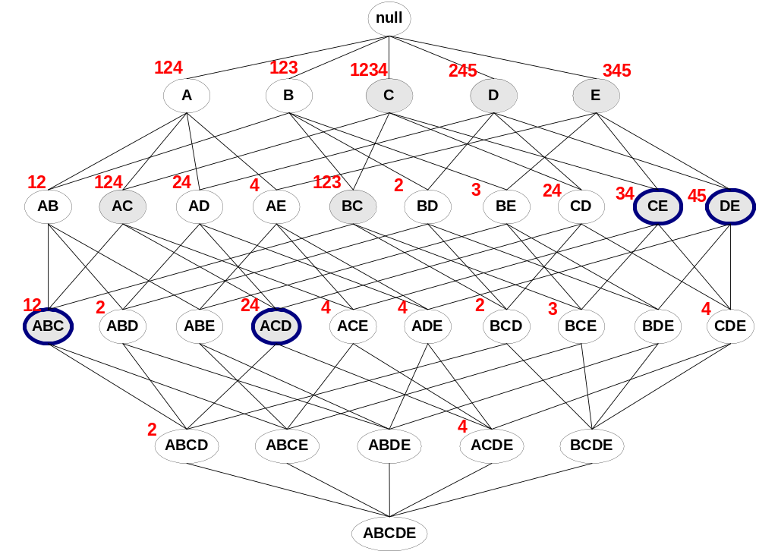
Maximal vs Closed Frequent Itemsets
Minimum support = 2
Closed but not maximal
Closed and maximal

Slide 12
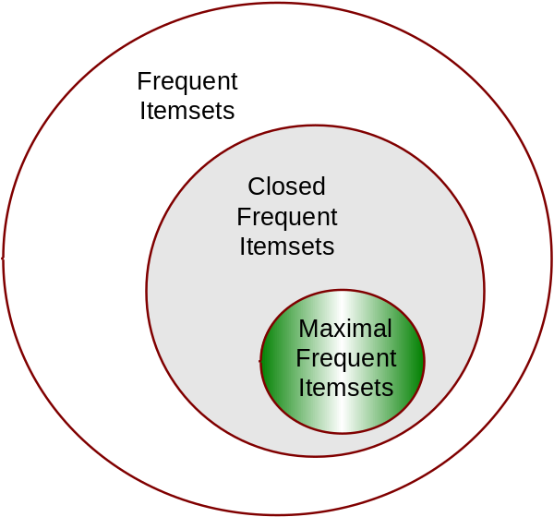
Maximal vs Closed Itemsets
Closed frequent itemsets are useful for removing some of the redundant association rules.
An association rule X -> Y is redundant if there exists another rule X’ -> Y’, where X is a subset of X’ and Y is a subset of Y’, such that the support and confidence for both rules are identical
In the previous example, {b} is not a closed frequent itemset, while {b, c} is closed
The association rule {b} -> {d, e} is therefore redundant as it has the same support and confidence as {b, c} -> {d, e}
Such redundant rules are not generated if closed frequent itemsets are used for rule generation
Note that, all maximal frequent itemsets are closed be cause none of them can have the same support count as their immediate supersets
The relationships among frequent, maximal frequent and closed frequent itemsets are shown below:

Slide 13
Pattern Evaluation
Association rule algorithms tend to produce too many rules
  many of them are uninteresting or redundant
  Redundant if {A,B,C} → {D} and {A,B} → {D}
  have same support & confidence
Interestingness measures can be used to prune/rank the derived patterns
In the original formulation of association rules, support & confidence are the only measures used

Slide 14
Pattern Evaluation
It is important to establish a set of well-accepted criteria for evaluating the quality of association patterns
The first set of criteria can be established through statistical arguments. Patterns that involve a set of mutually independent items or cover very few transactions are considered uninteresting because they may capture spurious relationships in the data
Such patterns can be eliminated by applying an objective interestingness measure that uses statistics derived from the data to determine whether a pattern is interesting
Examples of objective interestingness measures include support, confidence and correlation
The second set of criteria can be established through subjective arguments. A pattern is considered subjectively uninteresting unless it reveals unexpected profitable actions
For example, the rule {Butter} -> {Bread} may not be interesting, despite having high support and confidence values, because the relationship represented by the rule may seem rather obvious.
On the other hand, the rule {Diapers} -> {Beer} is interesting because the relationship is quite unexpected and may suggest a new cross-selling opportunity for retailers
Incorporating subjective knowledge into pattern evaluation is a difficult task because it requires a considerable amount of prior information from the domain experts

Slide 15
Pattern Evaluation
Objective Measures of Interestingness
An objective measure is a data driven approach for evaluating the quality of association patterns
It is domain independent and requires minimal input from the users other than to specify a threshold for filtering low-quality patterns
An objective measure is usually computed based on the frequency counts tabulated in a contingency table
f₁₁: support count of X and Y
f₁₀: support count of X and Y
f₀₁: support count of X and Y
f₀₀: support count of X and Y
Contingency table for X → Y
 | Y | Y
X | f₁₁ | f₁₀ | f₁₊
X | f₀₁ | f₀₀ | f_{o+}
 | f₊₁ | f₊₀ | |T|
Used to define various measures
support, confidence, lift, Gini,
J-measure, etc.

Slide 16
Drawback of Confidence
 | Coffee | Coffee
Tea | 15 | 5 | 20
Tea | 75 | 5 | 80
 | 90 | 10 | 100
Association Rule: Tea → Coffee
Confidence= P(Coffee|Tea) = 0.75
but P(Coffee) = 0.9
Although confidence is high, rule is misleading, as 90% of people drink coffee anyway
P(Coffee|Tea) = 0.9375

Slide 17
Statistical Independence
Population of 1000 students
  600 students know how to swim (S)
  700 students know how to bike (B)
  420 students know how to swim and bike (S,B)
  P(S∧B) = 420/1000 = 0.42
  P(S) × P(B) = 0.6 × 0.7 = 0.42
  P(S∧B) = P(S) × P(B) => Statistical independence
  P(S∧B) > P(S) × P(B) => Positively correlated
  P(S∧B) < P(S) × P(B) => Negatively correlated

Slide 18




Statistical Measures
Interest Factor: The tea-coffee example shows that high confidence rules can sometimes be misleading because the confidence measure ignores the support of the itemset appearing in the rule consequent. One way to address this problem is by applying a metric known as lift:
which computes the ratio between the rule’s confidence and the support of the itemset in the rule consequent. Lift is equivalent to another objective measure called interest factor, which is defined as follows:
Interest factor compares the frequency of a pattern against a baseline frequency computed under the statistical independence assumption. The baseline frequency of a pair of mutually independent variables is
or equivalently,

Slide 19
Statistical-based Measures
This equation follows the standard approach of using simple fractions as estimates for probabilities.
The fraction f11 / N is an estimate for the joint probability P(A,B), while f1+ / N and f+1/N are the estimates for P(A) and P(B) respectively.
If A and B are statistically independent, then P(A,B) = P(A).P(B), thus leading to the formula shown in the previous slide
Using these equations, we can interpret the interest measure as follows:
I(A,B) = 1, if A and B are independent
I(A,B) > 1, if A and B are positively correlated
I(A,B) < 1, if A and B are negatively correlated

Slide 20
Example: Lift/Interest
 | Coffee | Coffee
Tea | 15 | 5 | 20
Tea | 75 | 5 | 80
 | 90 | 10 | 100
Association Rule: Tea → Coffee
Confidence= P(Coffee|Tea) = 0.75
but P(Coffee) = 0.9
Lift = 0.75/0.9= 0.8333 (< 1, therefore is negatively associated)

Slide 21
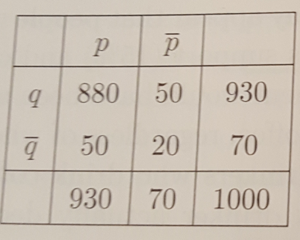
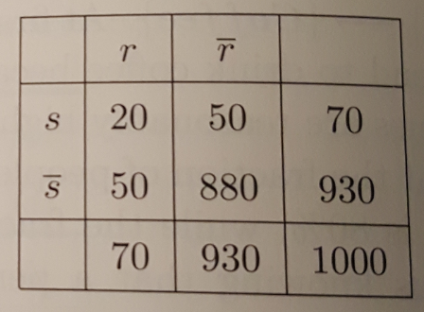
Drawback of Interest Factor
The limitation of interest factor can be illustrated with an example from the text mining domain. In text mining, it is reasonable to assume that the association between a pair of words depends on the number of documents that contain both the words. For example, we expect the words “data” and “mining” to appear together more frequently than the words “compiler” and “mining” in a collection of computer science articles.
The tables above show the frequency of occurrences of between two pairs of words {p,q} and {r,s}. The first table produces I = 1.02 while the second produces I = 4.08
From the first table, we note that p and q occur together in 88% of the documents. But the interest factor is close to 1, which is the value when p and q are statistically independent
In the second table, r and s seldom appear together, but their interest factor is much higher.
Confidence is perhaps a better choice in such situations, as it considers the association between p and q (94.6%) to be much stronger than that between r and s (28.6%)

Slide 22

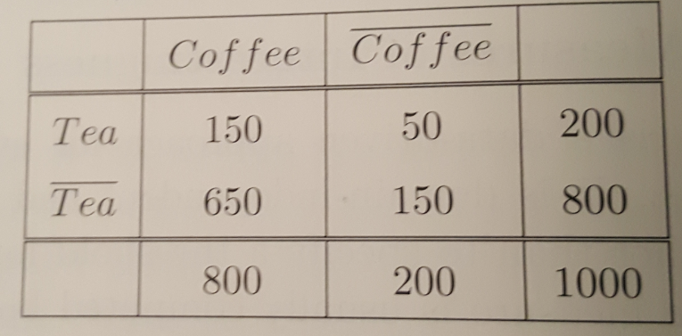
Correlation Analysis
Correlation analysis is a statistics based technique for analyzing relationships between a pair of variables
For continuous variables, correlation is defined using Pearson’s correlation coefficient
For binary variables, correlation can be computed as follows:
The value of correlation ranges from -1 (perfect negative correlation) to +1 (perfect positive correlation)
If the variables are statistically independent, then correlation is 0
For example, the correlation between tea and coffee drinkers given in the table is -0.0625

Slide 23
Limitations of Correlation Analysis
The drawback of using correlation can be seen from the word association tables given below:
Although the words p and q appear together more often than r and s, their correlation coefficients are identical and is equal to 0.232
This is because the correlation coefficient gives equal importance to both co-presence and co-absence of items in a transaction
It is therefore more suitable for analyzing symmetric binary variables
Another limitation of this measure is that it does not remain invariant when there are proportional changes to the sample size

Slide 24


IS Measure
IS is an alternative measure that has been proposed for handling asymmetric binary variables. It is defined as follows:
Note that IS is large when the interest factor and the support of the pattern are large
IS for the word pairs {p,q} and {r,s} are 0.946 and 0.286 respectively
The IS measure suggests that the association between {p,q} is stronger than {r,s} which agrees with what we expect from word associations in documents
IS is mathematically equivalent to the cosine similarity for binary variables
Considering A and B as a pair of bit vectors, we have A.B = s(A,B) and the magnitude of A as |A| = sqrt(s(A))

Slide 25
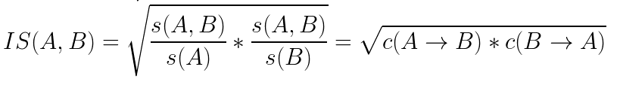


IS Measure
The IS measure can also be expressed as the geometric mean between the confidence of the association rules extracted from a pair of binary variables
Because the geometric mean between any two numbers is always closer to the smaller number, the IS value of an itemset {p,q} is low whenever one of its rules p -> q or q -> p has low confidence
For a pair of independent variables, the IS measure reduces to

